Slide 1
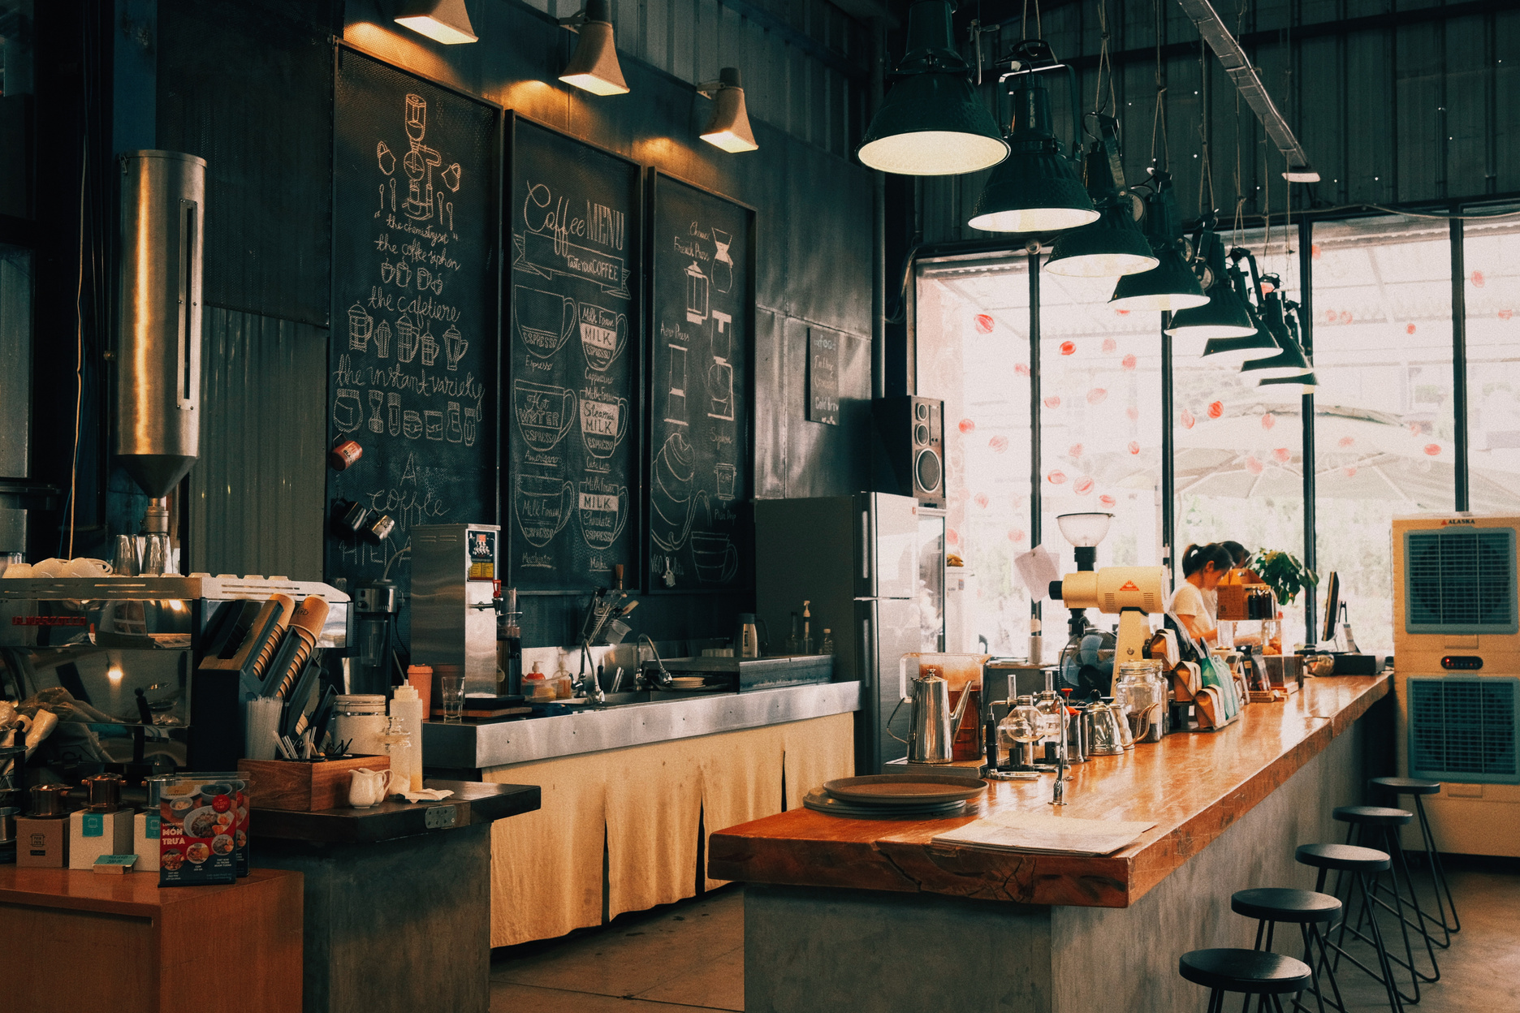

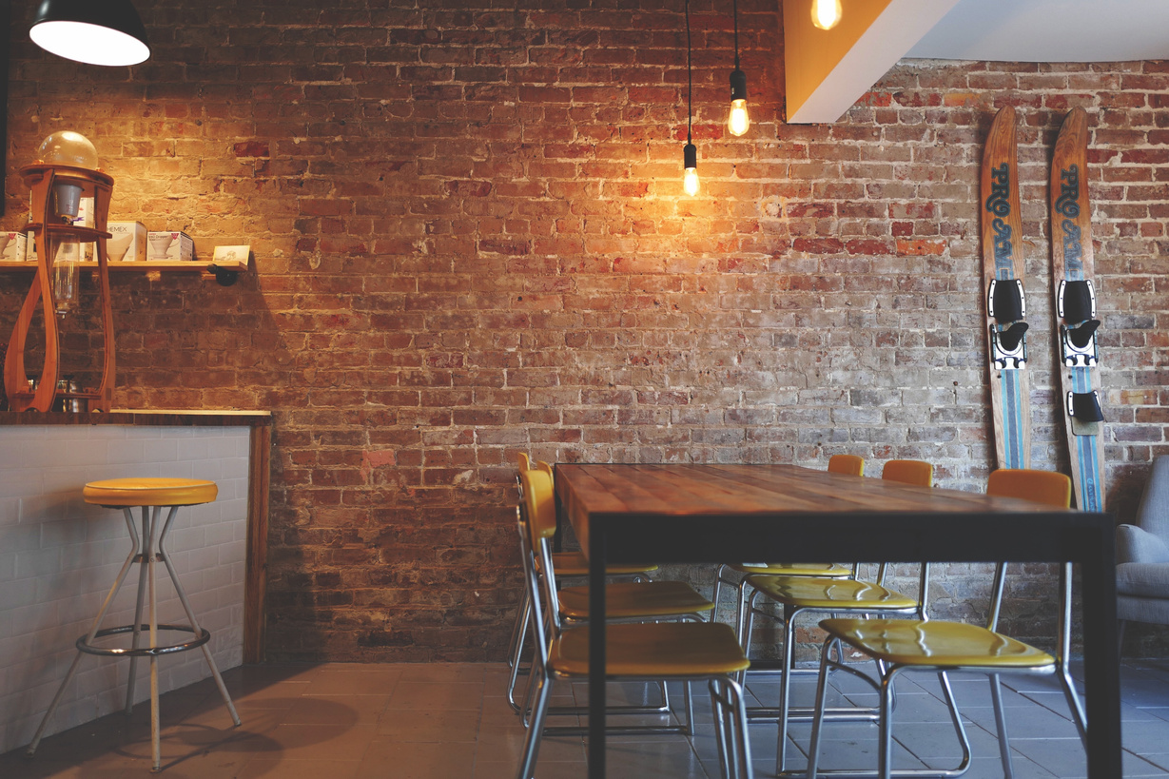
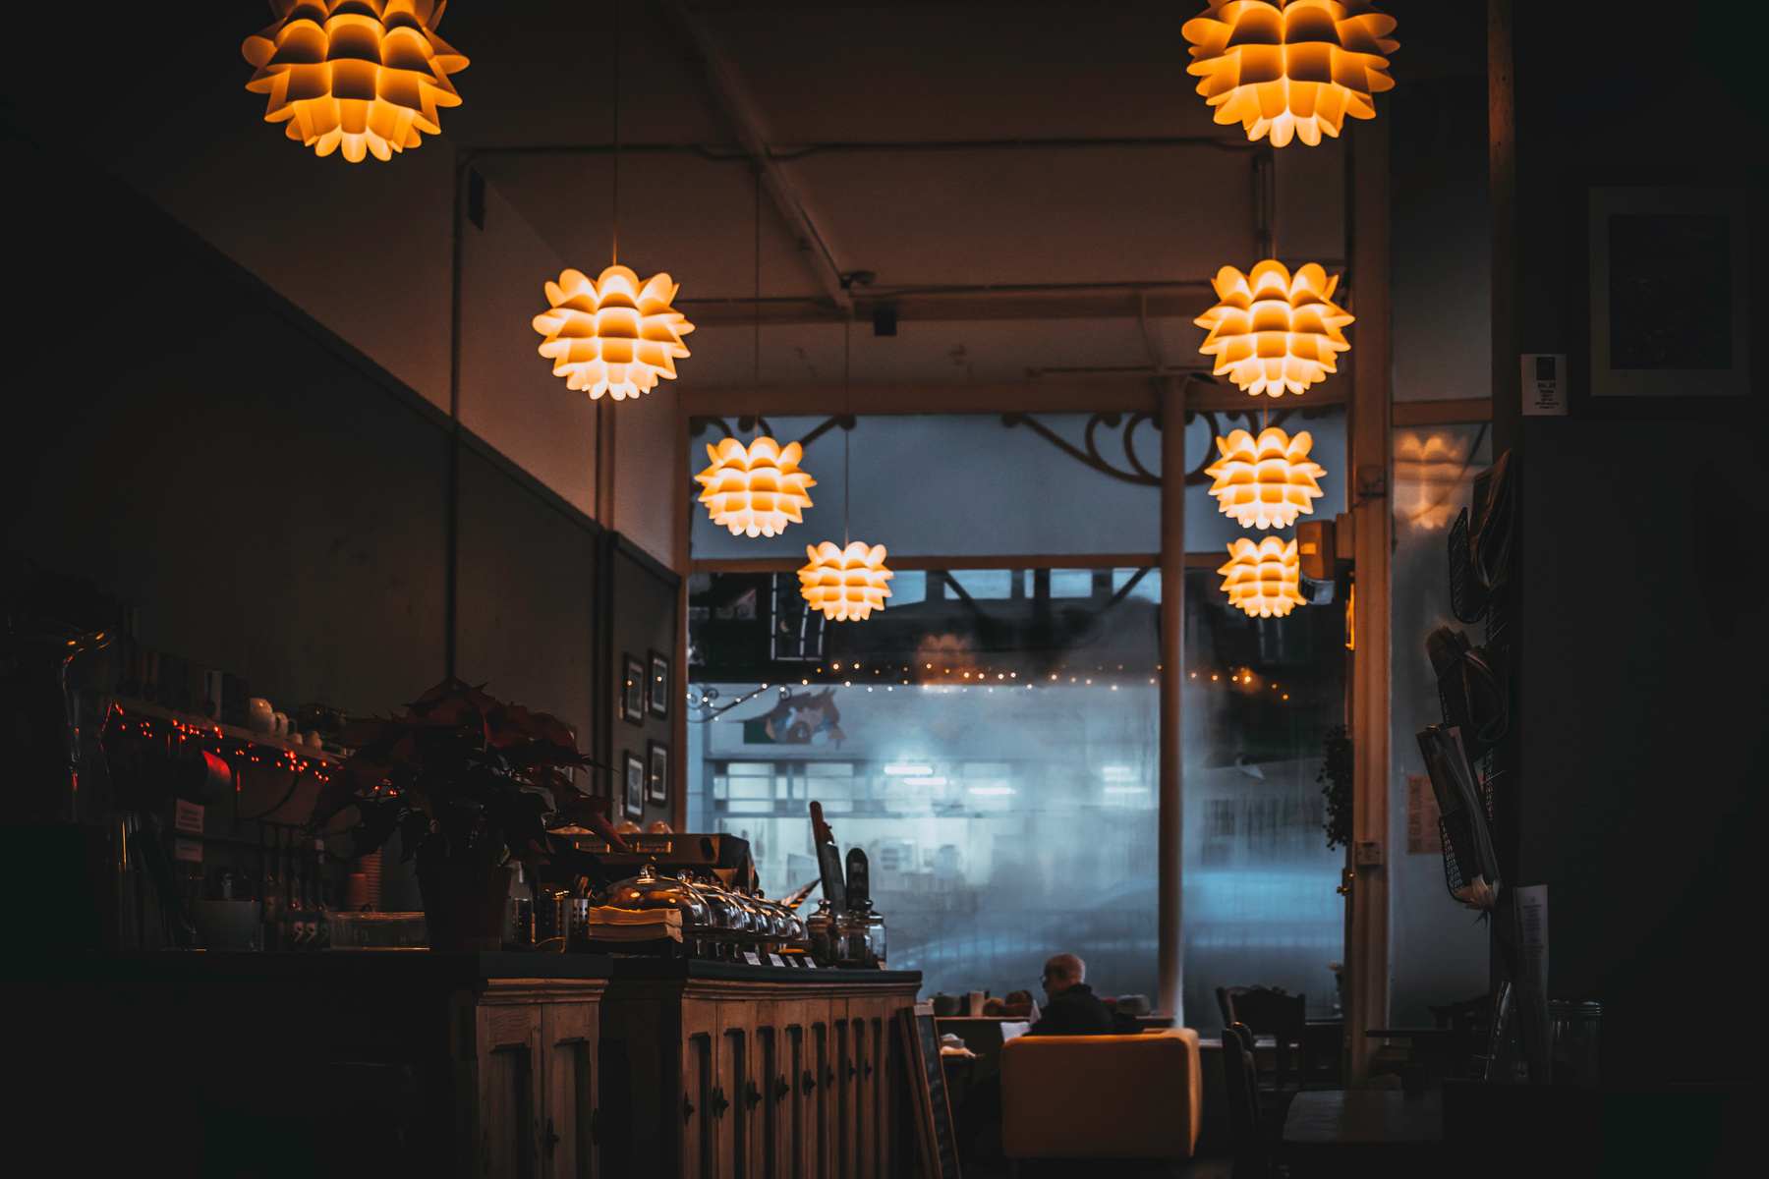
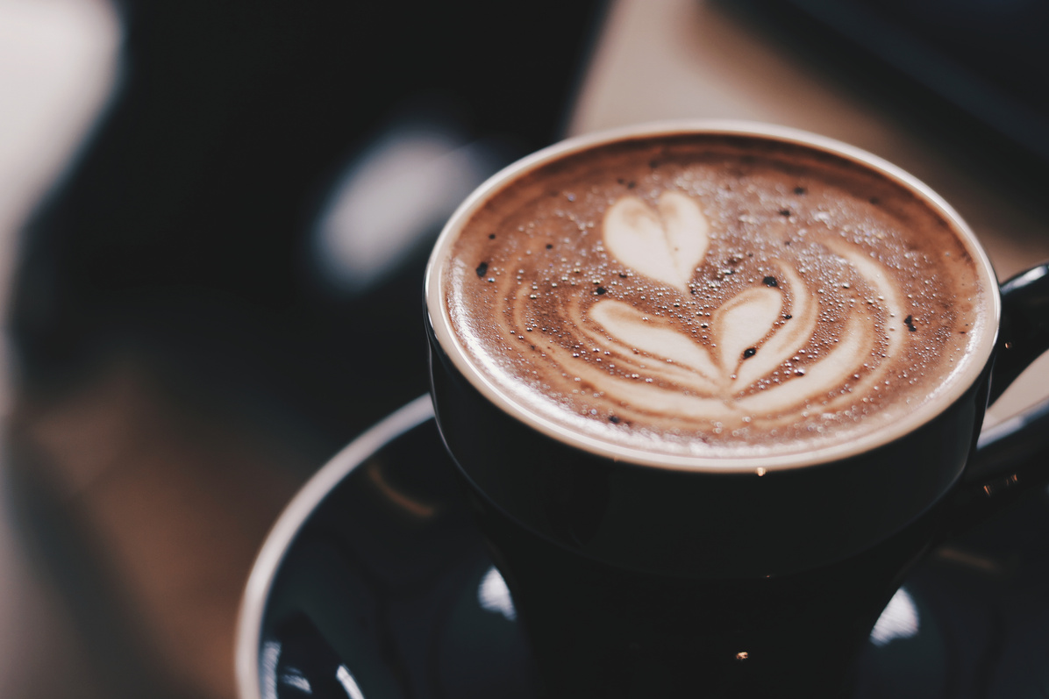

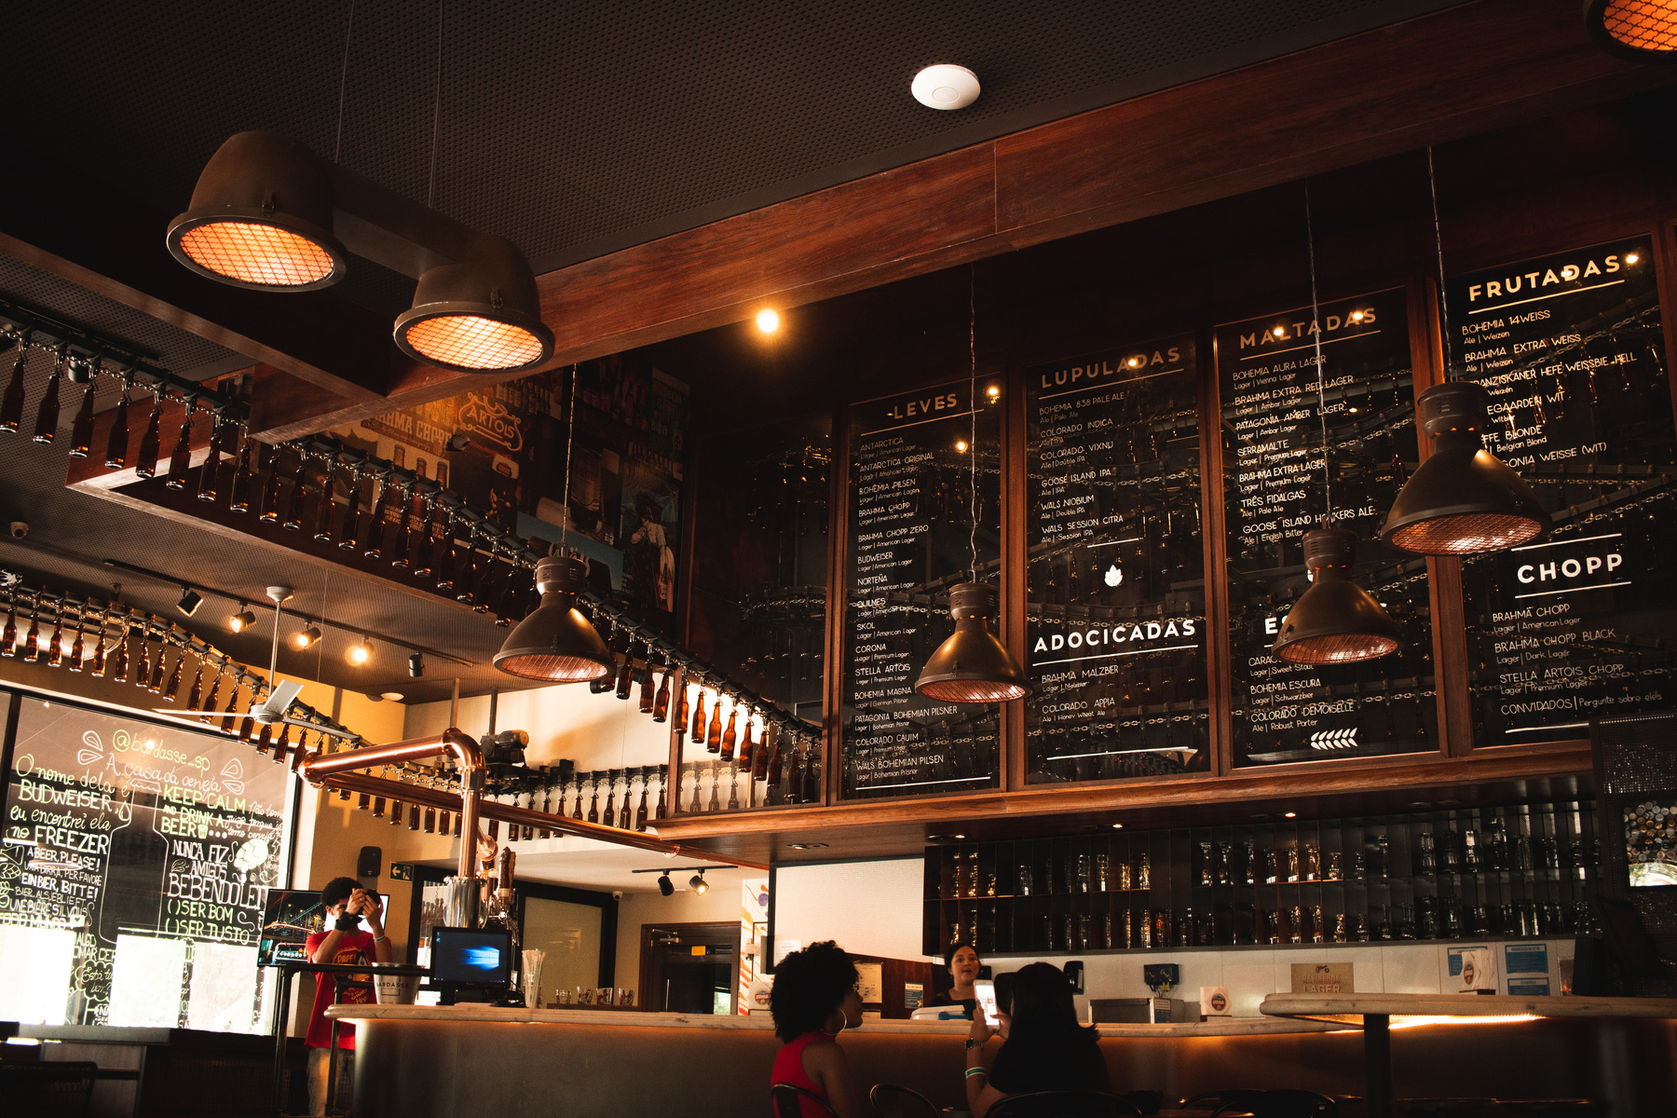
PROJECT
ORDER A DRINK APP WITH SQLITE
MUHAMMAD RYAN CAKRANINGRAT

Slide 2


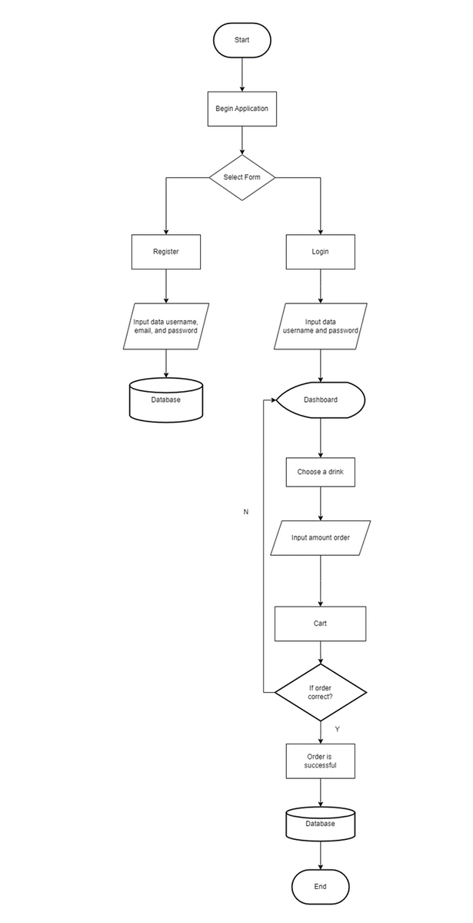
FLOWCHART

Slide 3
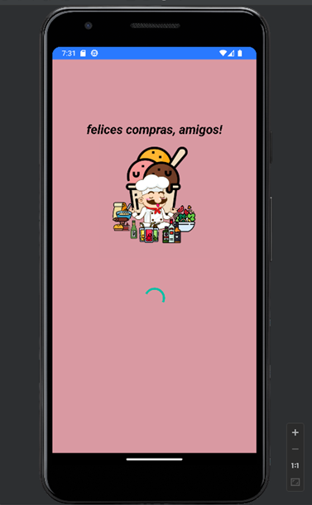
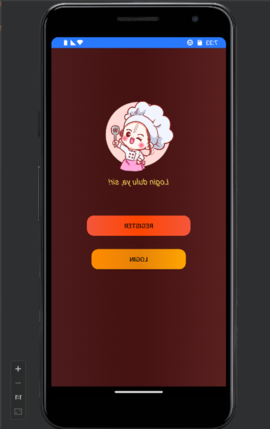

OUTPUT PROGRAM
After running the code, a loading screen will appear like this then proceed to welcomeActivity which is the initial display while heading to the application
LOADING SCREEM AND WELCOME

Slide 4
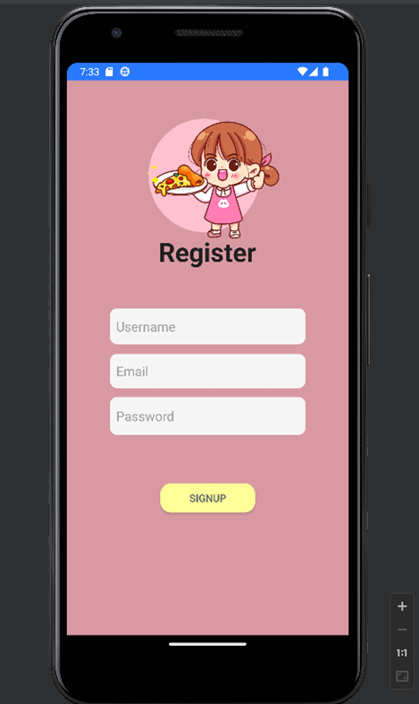
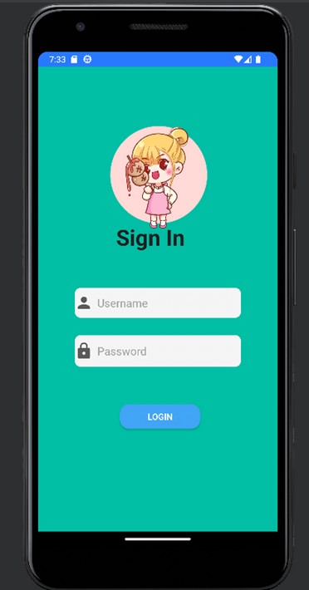
OUTPUT PROGRAM
If we have already registered for an account, we don’t need to do it again, but if not we must first fill it out
INPUT USER DATA AND SIGN IN

Slide 5
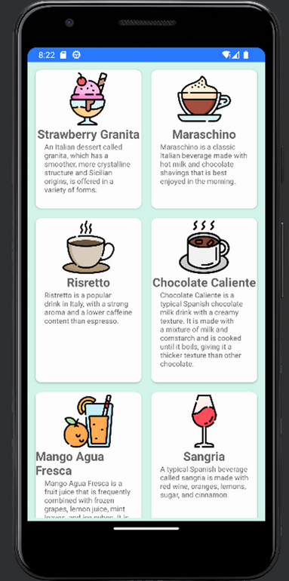
OUTPUT PROGRAM
After successfully logging in, we can immediately choose the available drinks and in this application users can choose 3 different drink menus in each of 3 countries
CHOOSE A TYPE OF DRINK

Slide 6
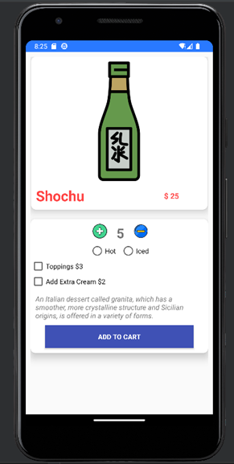
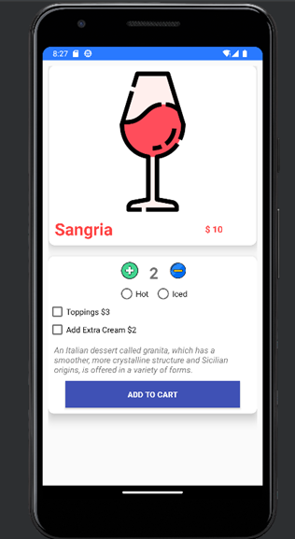
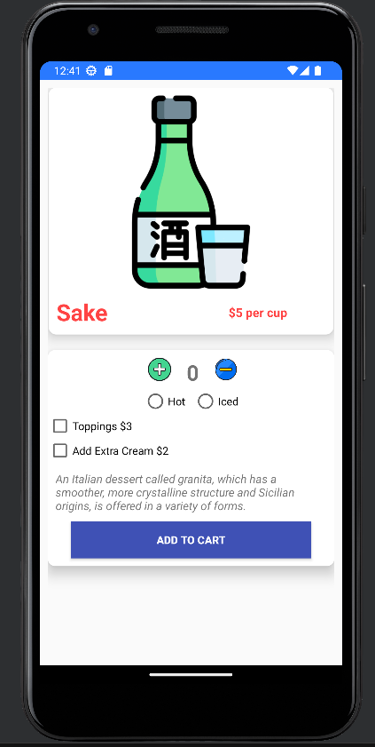
OUTPUT PROGRAM
After we choose the various type of drinks we can choose how much to order and also the various extras available
INFO EACH DRINK

Slide 7
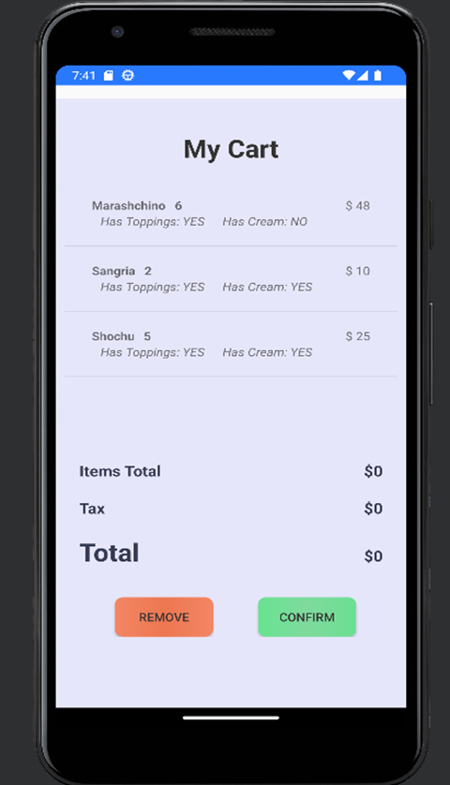
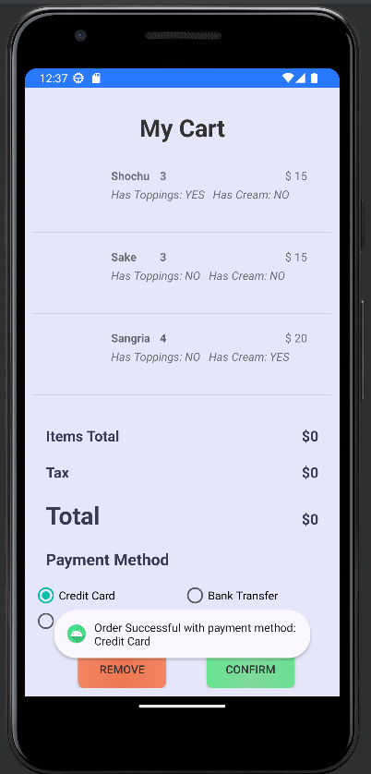
OUTPUT PROGRAM
Every menu that the user choose will appear in this activity then if the user has an error in entering data, you can use the remove button to delete the order and if its correct you can press confirm to continue transaction.
ORDER BASKET CART

Slide 8
Conclusion
This Drink Order Application Program uses an SQLite Database to store user data, including Registration/Login Information and Orders made by users. A wide variety of Drinks from countries including Italy, Spain and Japan are available in this app. The customer can choose the right Drink for him before placing his order in the basket, which can be removed if there is a matching order. After selecting payment the user can click the confirmation button to then be able to complete the transaction.

Slide 9
THANK YOU

